Slide 1


Lab 1 - Introduction to Task Planning
AIR 24-25
Ido Jacobi & Shiran Peeran & Sarah Keren

Slide 2
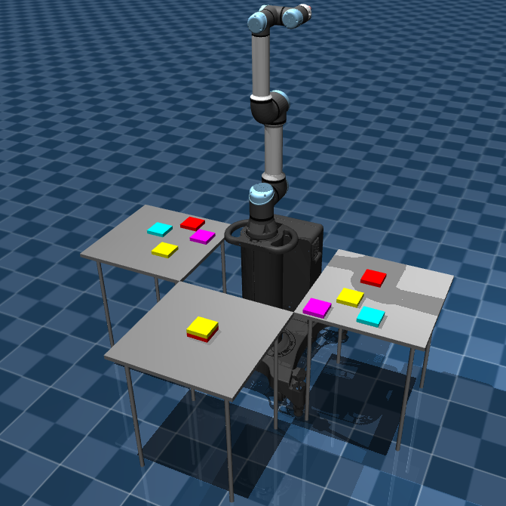

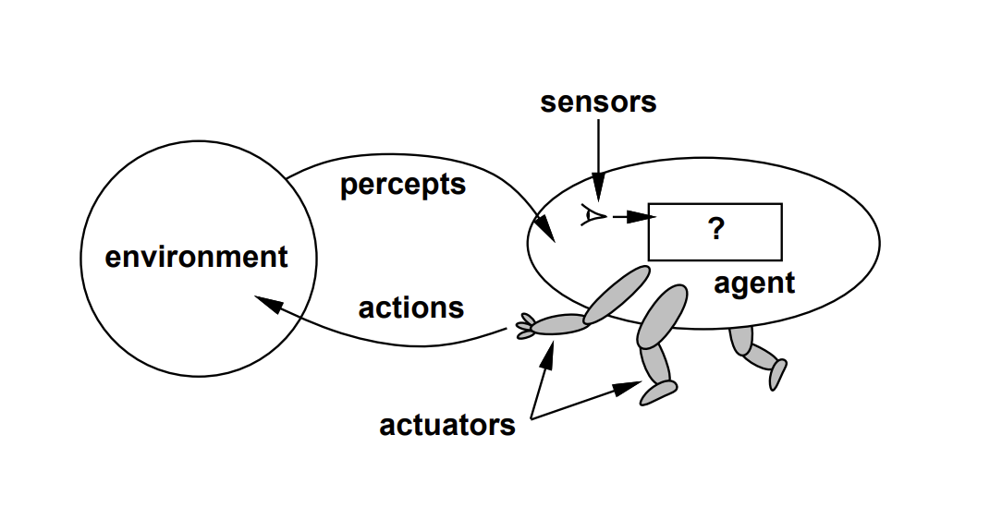
Course and Lab Objectives
The focus of this course: robotic agents that need to perform complex tasks that require
high-level reasoning and planning
understanding of how to move and operate in the physical environment
We will start by exploring task planning and explore the limitations of task planning for robotic agents.
The labs are meant to complement the theoretical material learned in class with in-depth exploration of some of the ideas we learned and with some hands-on experience on getting robots to do what we want them to do

Slide 3
Technical Details
The tutorials are provided in the form of Jupyter notebooks, suitable for running online via Google Colab.
Basic knowledge of Python and PDDL is required.
At the beginning of each notebook, there is a link to run it on Colab.
If you would like to run the notebooks locally on your machine, you can download them, but some installations may be required (e.g., numpy).
Each lab will include a presentation (like this one) and a complementary Google notebook with which you can practice the learned ideas.
Our repo: https://github.com/CLAIR-LAB-TECHNION/AIR

Slide 4
Lab 1 - Objectives
Getting to know the complexities of task planning for robotic settings
Understanding PDDL and its limitations of in representing complex settings
Understanding the need to integrate task and motion planning

Slide 5
Lab 1 - Tasks
Getting familiar with PDDL
Solving PDDL problems using Best First Search and formulating a heuristic fundtion
Understanding the expressive limitations of PDDL

Slide 6
Task Planning with PDDL

Slide 7
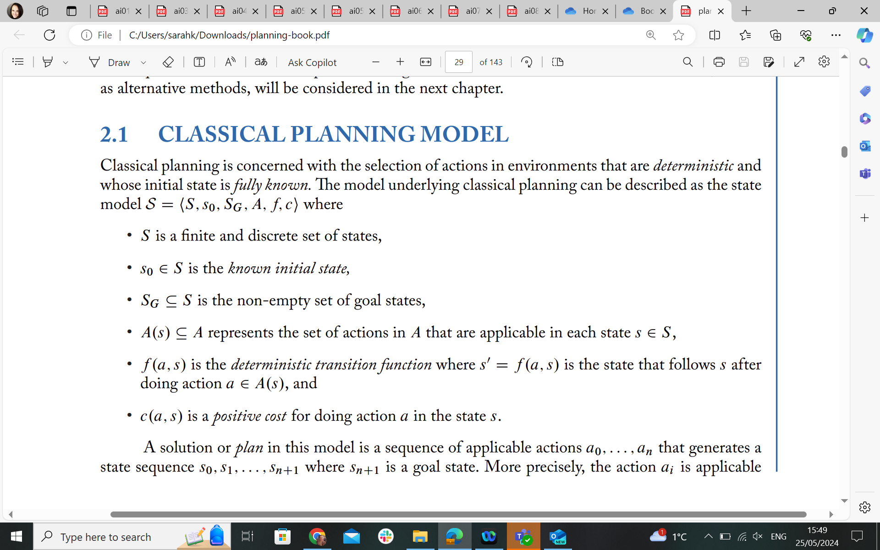
Task Planning - Classical Formulation
State space induced by feature set V
Geffner, Hector, and Blai Bonet. A concise introduction to models and methods for automated planning. Springer Nature, 2022.

Slide 8
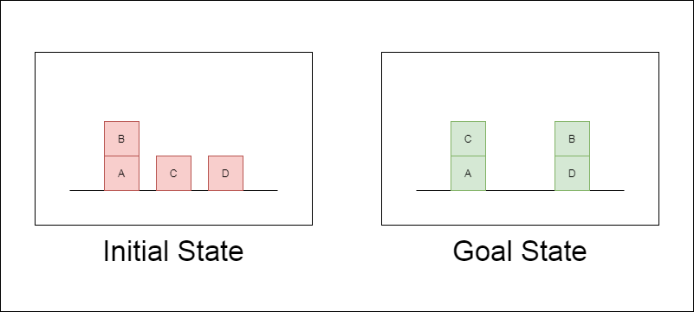
A blocks world example
Image from https://apoorvdixit619.medium.com/goal-stack-planning-for-blocks-world-problem-41779d090f29

Slide 9
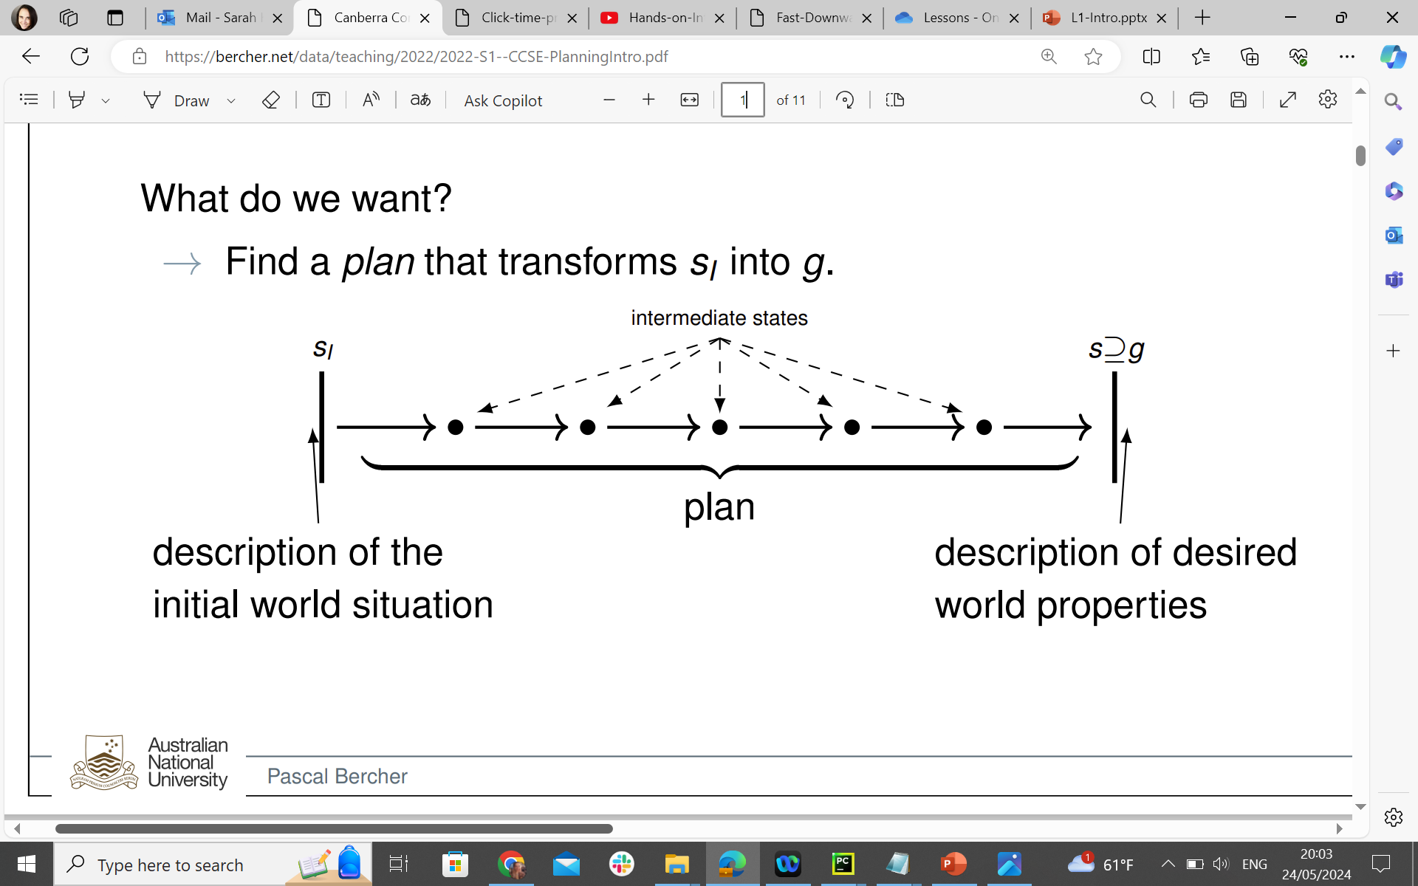
Planning
Diagram by Pascal Bercher
Classical planning: discrete, deterministic, fully observable and single agent.
Problem description induces a state transition system, with nodes as states and actions as transitions.
Becomes very complex very quickly: state space is 2^|V|, where V is the number of state features

Slide 10

Pickup B -> Stack B on D -> Pickup C -> Stack C on A

Slide 11
STRIPS and PDDL
⟨𝒱,𝐼,𝐺,𝐴⟩
finite set of state variables
finite set of actions with each action has the following components:
pre(a) ⊆𝑉: preconditions
add(a) ⊆𝑉: add effects
del(a) ⊆𝑉: delete effects
cost(a)
initial state
goal variables
Geffner, Hector, and Blai Bonet. A concise introduction to models and methods for automated planning. Springer Nature, 2022.

Slide 12
STRIPS and PDDL
STRIPS (Stanford Research Institute Problem Solver) and PDDL (Planning Domain Definition Language) are both used to encoding planning problems.
PDDL is more expressive:
separate domain and problem definitions.
domain includes types, predicates, functions, and actions available.
The problem description allows describing the objects in the world, the initial state, and the goal.
STRIPS
PDDL
(:action move
:parameters (?x ?y ?z - block)
:precondition (and (on ?x ?y)
(clear ?x)
(clear ?z))
:effect (and (not (on ?x ?y))
(not (clear ?z))
(on ?x ?z)
(clear ?y))
)
Operator: MOVE(x, y, z)
Preconditions: ON(x,y), CLEAR(x), CLEAR(z)
Delete list: ON(x,y), CLEAR(z)
Add list: ON(x,z), CLEAR(y)

Slide 13
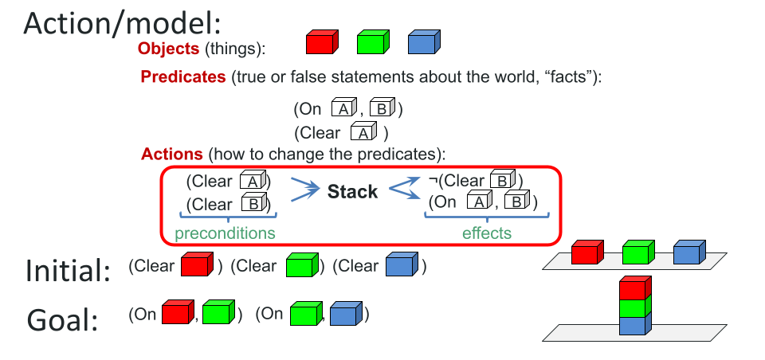
Formulation of Blocks World
slide by Erez Karpas

Slide 14
PDDL Formulation of Blocks World
(:types block)
(:predicates (on ?b1 ?b2 - block)
(clear ?b - block)
(handempty)
(holding ?b - block))
(:init
(handempty)(ontable D)(clear D)(on B A) ...)
(:goal (and
(on B D)(ontable D)
(on C A)(ontable A))))
(:action stack
:parameters (?b1 ?b2 - block)
:precondition (and (holding ?b1) (clear ?b2))
:effect
(and (not (holding ?b1))
(not (clear ?b2))
(clear ?b1)
(handempty)
(on ?b1 ?b2)))

Slide 15

Task 1
Writing a PDDL definition for a blocks world problem

Slide 16
Task Planning with Best First Search

Slide 17
Task Planning: Solution approaches
Common algorithms/techniques:
Search – forward, regression, bidirectional, symbolic
Compilation – to SAT, to CP
Partial Order Planning
Dynamic programming: Bellman Backup – i.e. for problems with uncertainty and rewards, like MDPs and POMDPs.
What are some general search algorithms?

Slide 18
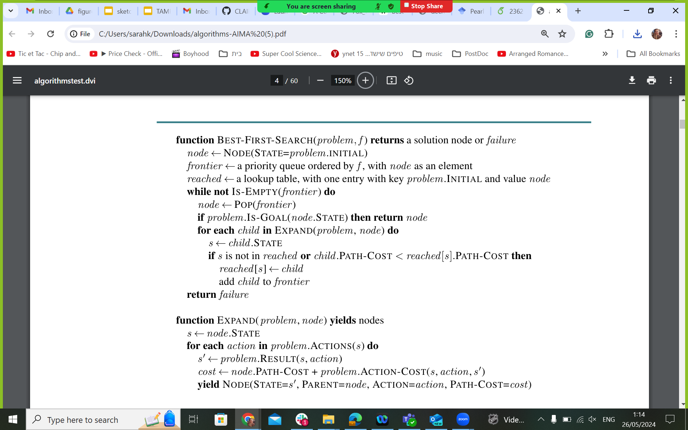
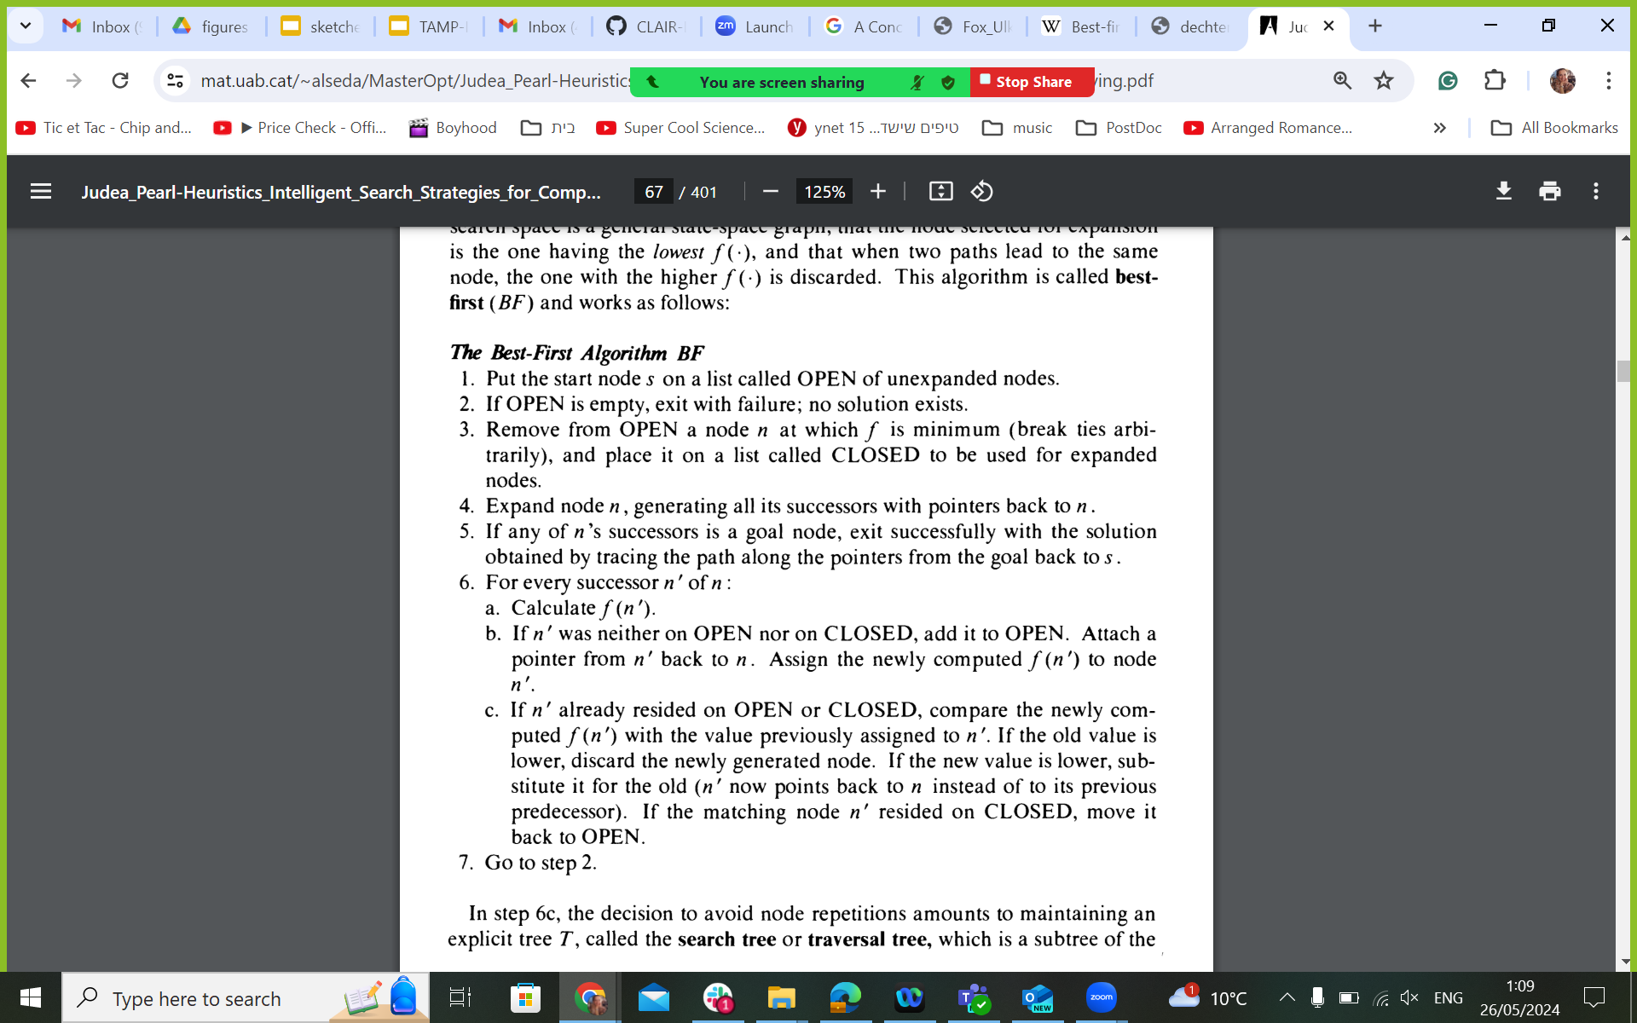
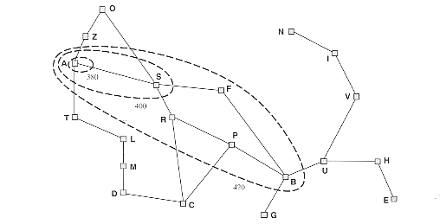
Best First Search
Code above from Norvig, P. Russel, and S. Artificial Intelligence. "A modern approach." Prentice Hall Upper
Pearl, Judea. Heuristics: intelligent search strategies for computer problem solving. Addison-Wesley Longman Publishing Co., Inc., 1984.

Slide 19
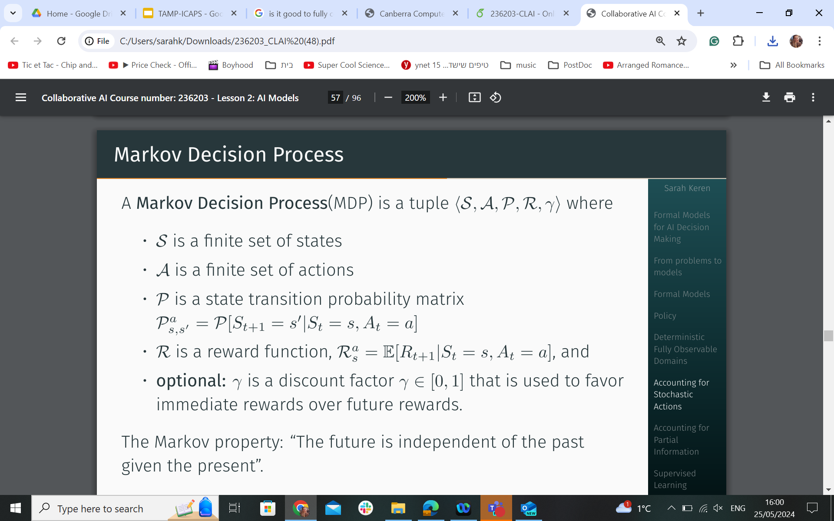
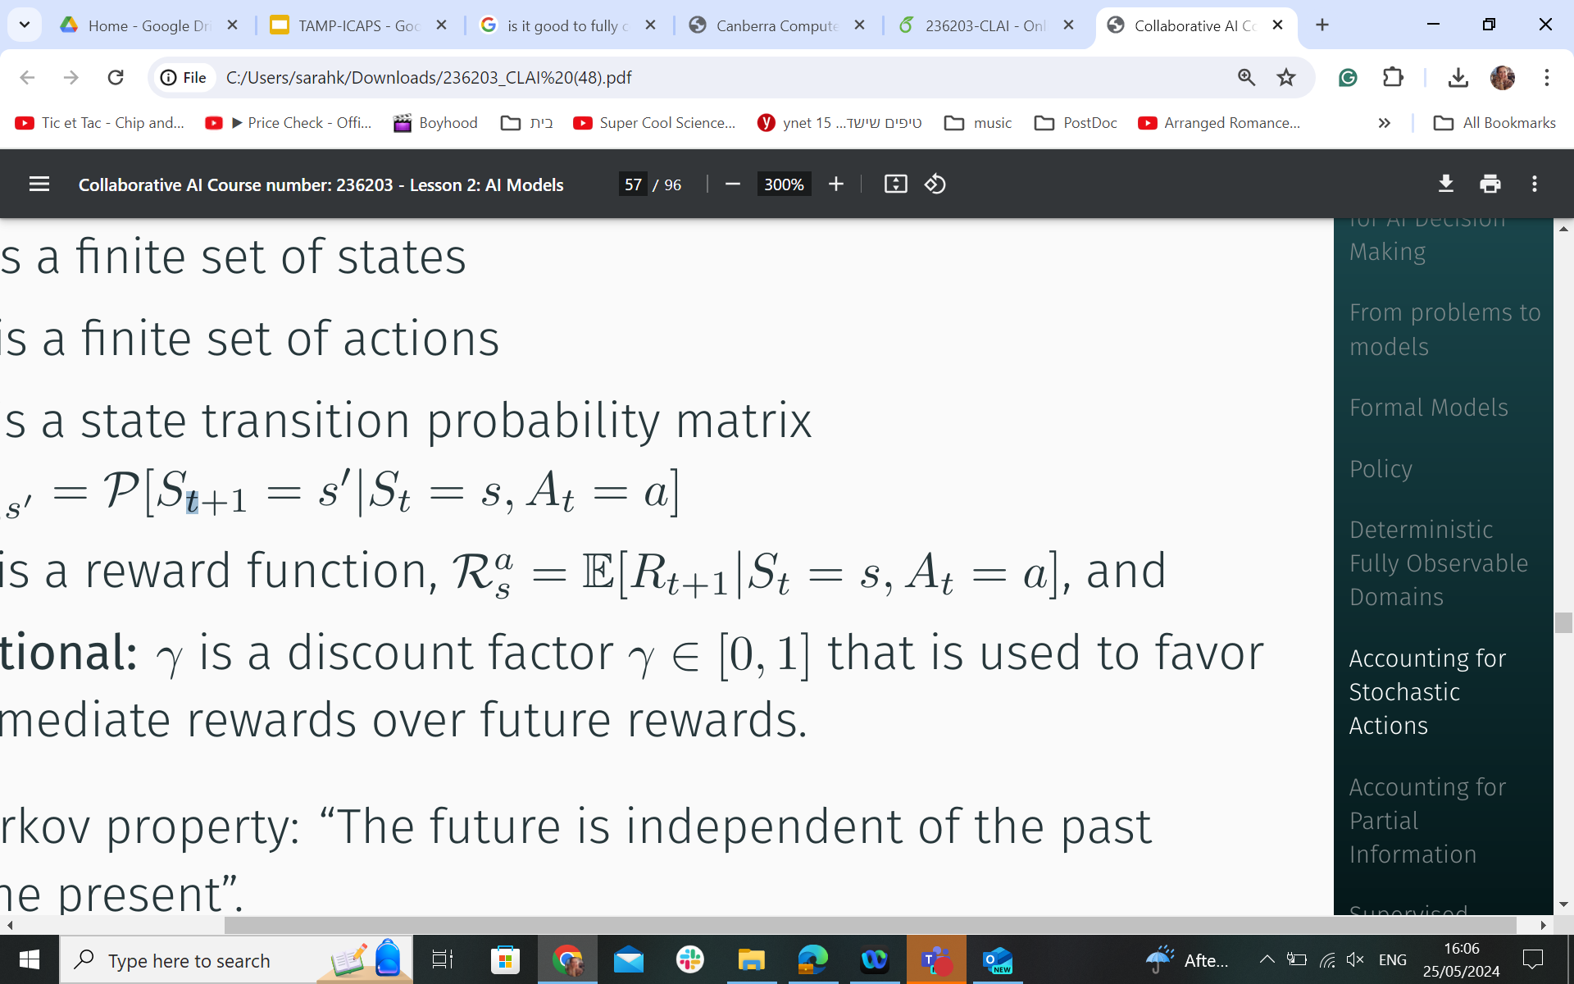
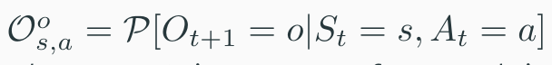
Task Planning - Extensions
Accounting for stochastic action outcome using a state transition probability function
Accounting for objectives using a reward function
Accounting for reward deprecation using a discount factor
Accounting for partial observability using observations Ω and observation function
Accounting for action duration, multiple agents, varying costs, etc.
Sequential decision making: what should the agent do to maximize total rewards?

Slide 20
A*
A* is a special case of Best First Search that uses a heuristic to guide the search from an initial state to a goal state.
Formally, the priority according to which A* extracts nodes from the frontier is: f(n)=g(n)+h(n) where:
n is the node that is considered,
g(n) is the cost of the path from the start node to n
h(n) is the heuristic estimation of the cost from n to a goal state.

Slide 21
Heuristic Functions
Heuristic functions are an important element of any heuristic search, and A* in particular.
Effective heuristics possess certain characteristics that enable the algorithm to efficiently find solutions while minimizing the search effort
Some key characteristics of heuristic functions:
Safeness
Goal Awareness
Admissibility
Efficiency

Slide 22
Task 2
Implementing a heuristic method

Slide 23
Are we done ?

Slide 24

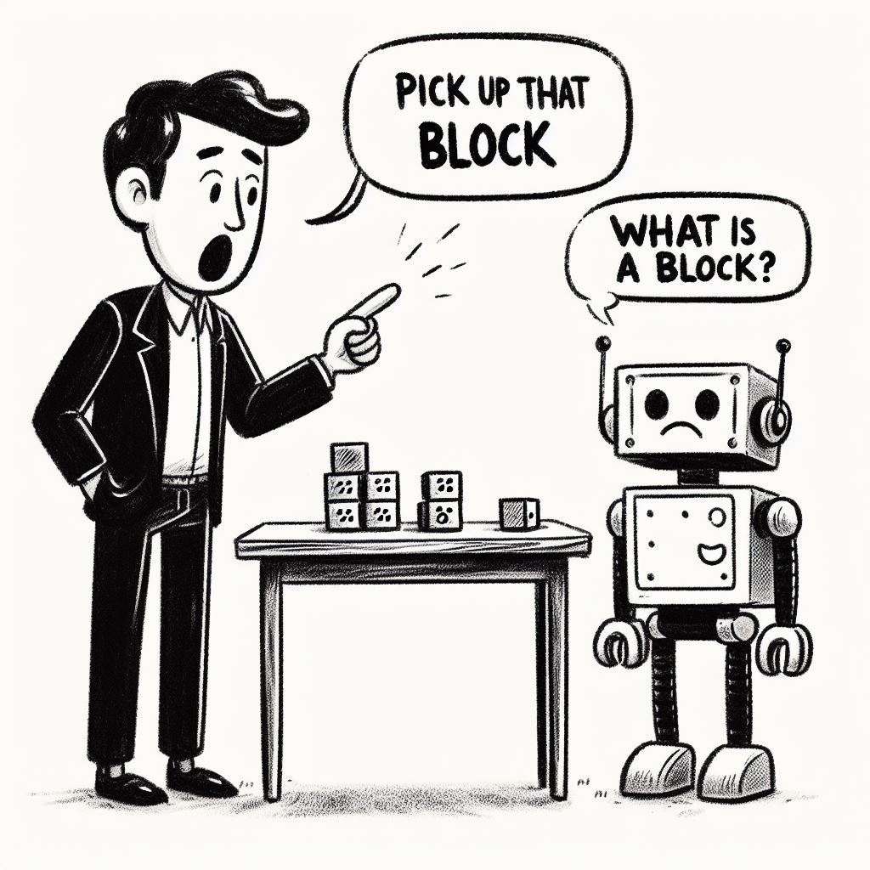
How does it know what a block is ?
How does it know how to stack, pick up and put down?
How does it know what’s the best way to pick up?

Slide 25

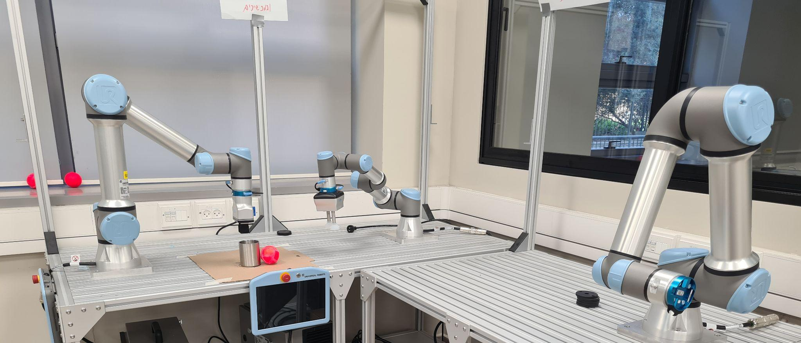
BW in the real(istic) world
What have we failed to capture with our PDDL formulations ?

Slide 26
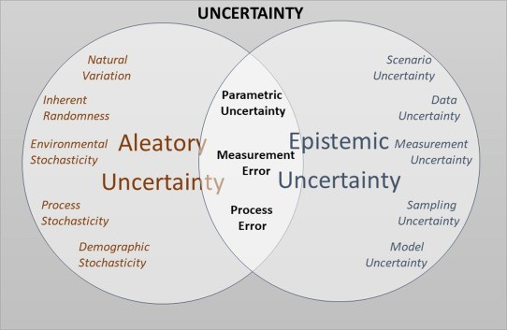
Task Planning vs. the Real World
Discrete: plans are finite sequences of actions - while actual actions are continuous
Fully modeled actions (deterministic in classical planning): while actual actions can have unexpected effects that are hard/impossible to model
Full knowledge of world state or of belief (distribution over possible world states) while knowing the actual state /distribution relies on complex sensing and reasoning
https://www.stat.berkeley.edu/users/aldous/157/Papers/Fox_Ulkumen.pdf

Slide 27
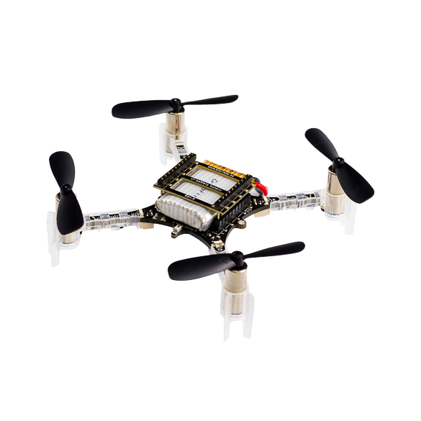

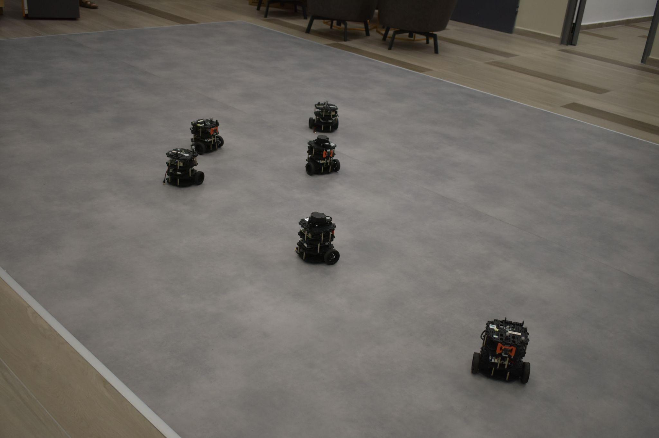
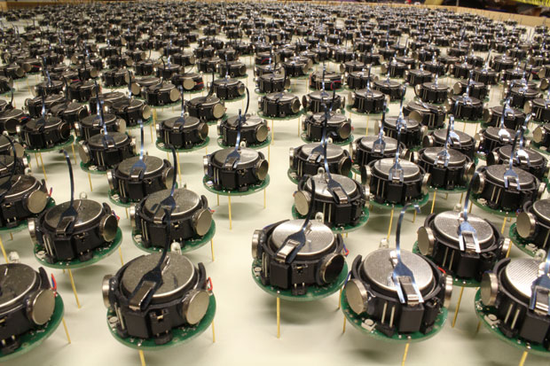
Many Types of Robots

Slide 28

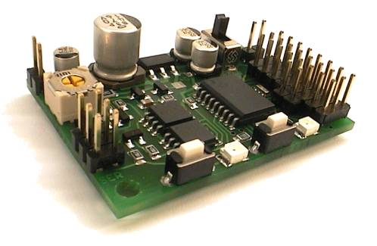
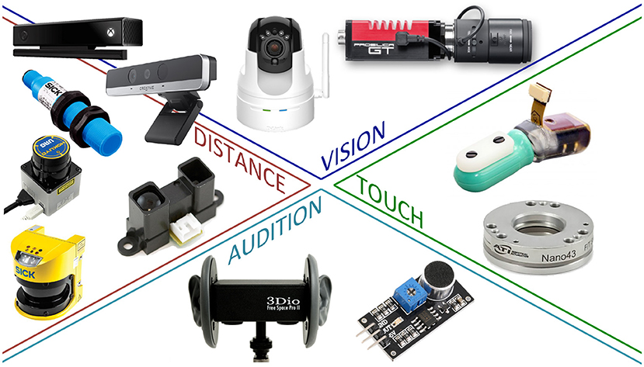

Robot Elements
Sensors
Controllers
Actuators
Image from: https://ieeexplore.ieee.org/abstract/document/6386486/

Slide 29
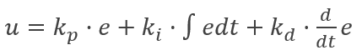
Robotic Agents
state estimation
decision making
motion control
Maintain a belief 𝛽 ∈ 𝜷 as a probability distribution over world states S
Find a policy, mapping belief 𝛽 and objective into actions (probabilities)
Translate actions into low-level commands (and monitor their execution)
𝛽:S→[0,1]
𝝅: 𝜷🗶A→[0,1]
https://eng-resources.charlotte.edu/unccengkit/coding/pid-control/

Slide 30
Robotic Agents
state estimation
decision making
motion control

Slide 31

decision making
(:action stack
:parameters (?b1 ?b2 - block)
:precondition (and (holding ?b1) (clear ?b2))
:effect
(and (not (holding ?b1))
(not (clear ?b2))
(clear ?b1)
(handempty)
(on ?b1 ?b2)))
state estimation
motion control
Task planning is not enough

Slide 32
What next ?

Slide 33
Things get messier: N-table Blocks World
Accounting for varying costs, collision avoidance, motion feasibility, multiple (infinite) positions from which an action can be performed, multiple (infinite) ways to reach a position

Slide 34

